Slide 1
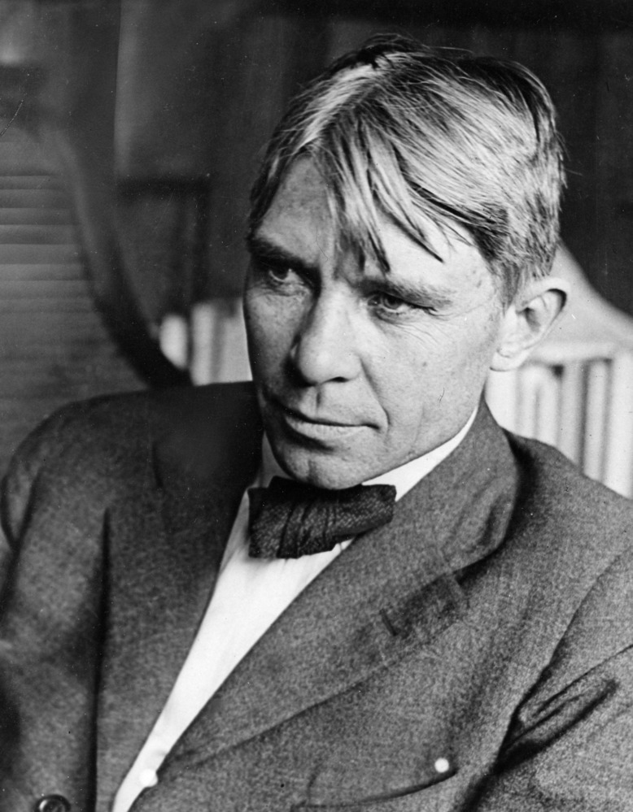
"Poet of the People“
Carl Sandburg provided a popular voice for the American people of the twentieth century and still speaks to us through his words, activism, music and the beauty and serenity of Carl Sandburg Home National Historic Site.
www.nps.gov/carl

Slide 2
Songs with Social Influence Grades 9-12
How do events in society influence artists, musicians, and writers?
How do they in turn influence society?
Tasks
Watch a video to learn about Carl Sandburg, listen to him read one of his poems, and listen to another artist sing from the American Songbag.
Select a Social Justice Song to analyze.
Find the lyrics to your song.
Answer Questions and submit.

Slide 3
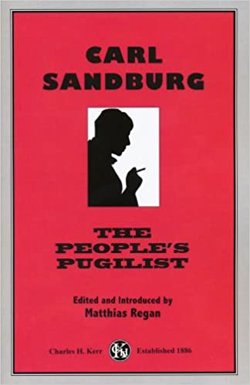
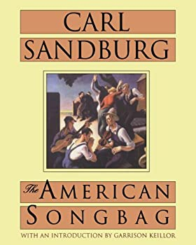
Carl Sandburg: Poet of the People
Carl Sandburg both influenced and was influenced by the world around him. He wrote poems and articles about the things he saw wrong with society. He also had a deep appreciation for music, especially folk music, the songs of “the people”. He often ended his lectures by playing his guitar and singing some of his favorite American folk songs.
In 1927, poet Carl Sandburg published The American Songbag which featured words and music to 280 songs and ballads that have been sung throughout American history. Many of these songs have themes like Sandburg’s poems and tell a story about peoples’ dreams and struggles.’’
Click this link https://www.youtube.com/watch?v=jS0TJT6H_KE to watch the video: Carl Sandburg Poet of the People
Click this link https://www.nps.gov//carl/learn/education/grass.htm to listen to the poem “Grass” read by Carl Sandburg.
Click this link https://www.youtube.com/watch?v=It8zkoYJIDo to hear the song “Ain’t Gonna Study War No More” by Nat King Cole from the “American Songbag.”

Slide 4
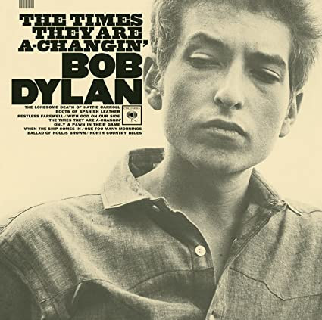
Sandburg and Dylan
Carl Sandburg was admired by many song writers and poets such as Bob Dylan. Like Sandburg, many of Dylan’s songs are wonderful examples of poems influenced by historic events. In the 1960’s Bob Dylan even stopped by Connemara to meet Carl Sandburg.
Sandburg wrote poems about what he saw wrong about society while Dylan wrote songs of protest.
Sandburg and Dylan visited for about twenty minutes on the front porch and talked about poetry and folk music. Despite their age difference, Sandburg and Dylan had much in common. They were both first generation Americans, born in the Midwest. They both admired Walt Whitman and Woody Guthrie and were collectors of folk songs that spoke for the voice of the people.

Slide 5
Songs with Social Influence Make a selection from the list below or choose your own song / poem for the assignment.
Youth Poetry slam with Aiya Meilani https://www.yousubtitles.com/Aiya-Youth-Speaks-Teen-Poetry-Slam-Finals-2019-id-2739391
Get Up Stand Up by Bob Marley https://www.youtube.com/watch?v=v7ZzlCP7oAw
Where is the Love by The Black Eyed Peas https://www.youtube.com/watch?v=WpYeekQkAdc&list=PLy_AmnYLyvV_MKycRRtpwc7p0iScyG0tp&index=13
Masters of War by Bob Dylan https://www.youtube.com/watch?v=JEmI_FT4YHU
For What its Worth by Buffalo Springfield https://www.youtube.com/watch?v=gp5JCrSXkJY
Change by Christina Aguilera https://www.youtube.com/watch?v=OBSghlH0JgM&list=PL3sb_NB3JljbLHGYhrLaNSmtdbO53-F5q&index=3

Slide 6
Find the lyrics from the song or poem you selected, then answer questions 1-4.
Question 1
What is the name of your song or poem, and who is the author or artist?
Question 2
What is the social issue the song or poem is addressing?

Slide 7
Continued…
Question 3
Why did you choose this song or poem?
Question 4
What current event could the song or poem relate to?

